Slide 1
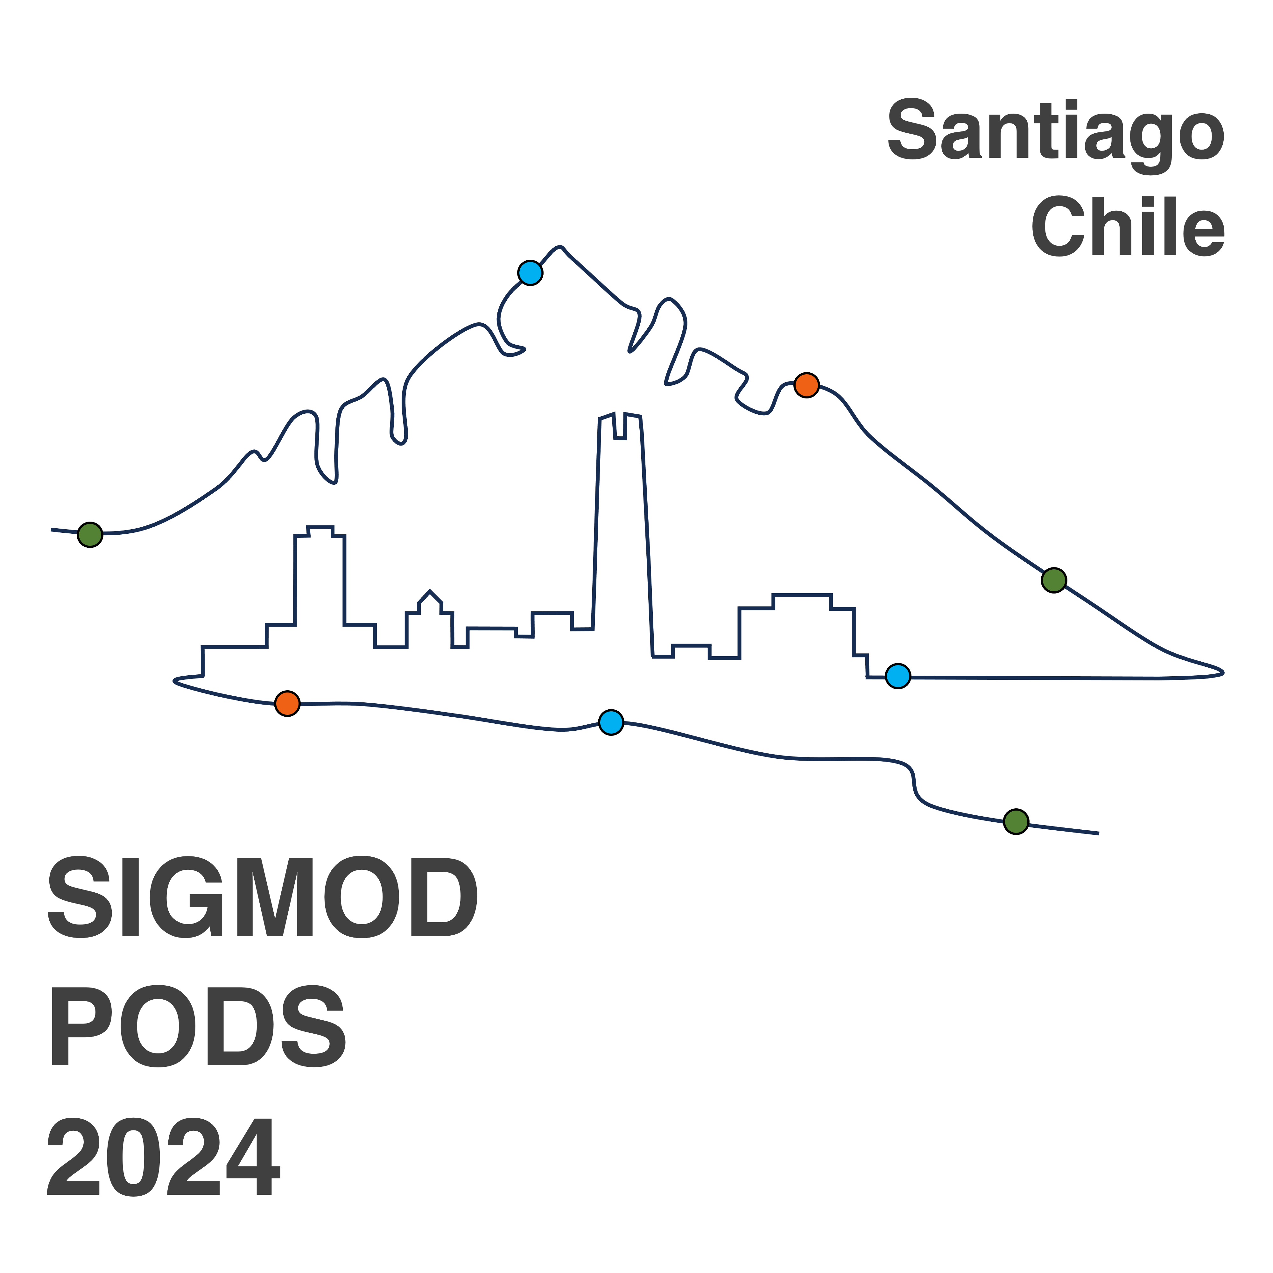



Demystifying the QoS and QoE of Edge-hosted Video Streaming Applications in the Wild with SNESet
Research Track
Data-intensive Applications (DIA) Special Track
Yanan Li^{1, 2}, Guangqing Deng², Changming Bai², Jingyu Yang², Gang Wang², Hao Zhang², Jin Bai², Haitao Yuan³, Mengwei Xu¹, Shangguang Wang¹
¹ State Key Laboratory of Networking and Switching Technology
² Alibaba Group
³ Nanyang Technological University
Notes:
Good afternoon, everyone.
I am Yanan Li from State Key Laboratory of Networking and Switching Technology.
Today ,I will introduce our work “”
This paper is a joint work of Alibaba Group, and Nanyang Technological University.

Slide 2




Background
Video streaming applications (VSAs) are gaining momentum📈.
On-demand
video
Video
conferencing
Live
streaming
Cloud
gaming
Notes:
Nowadays, video streaming applications (VSAs) are gaining momentum and occupy much of our daily lives, which can be categorized into .

Slide 3

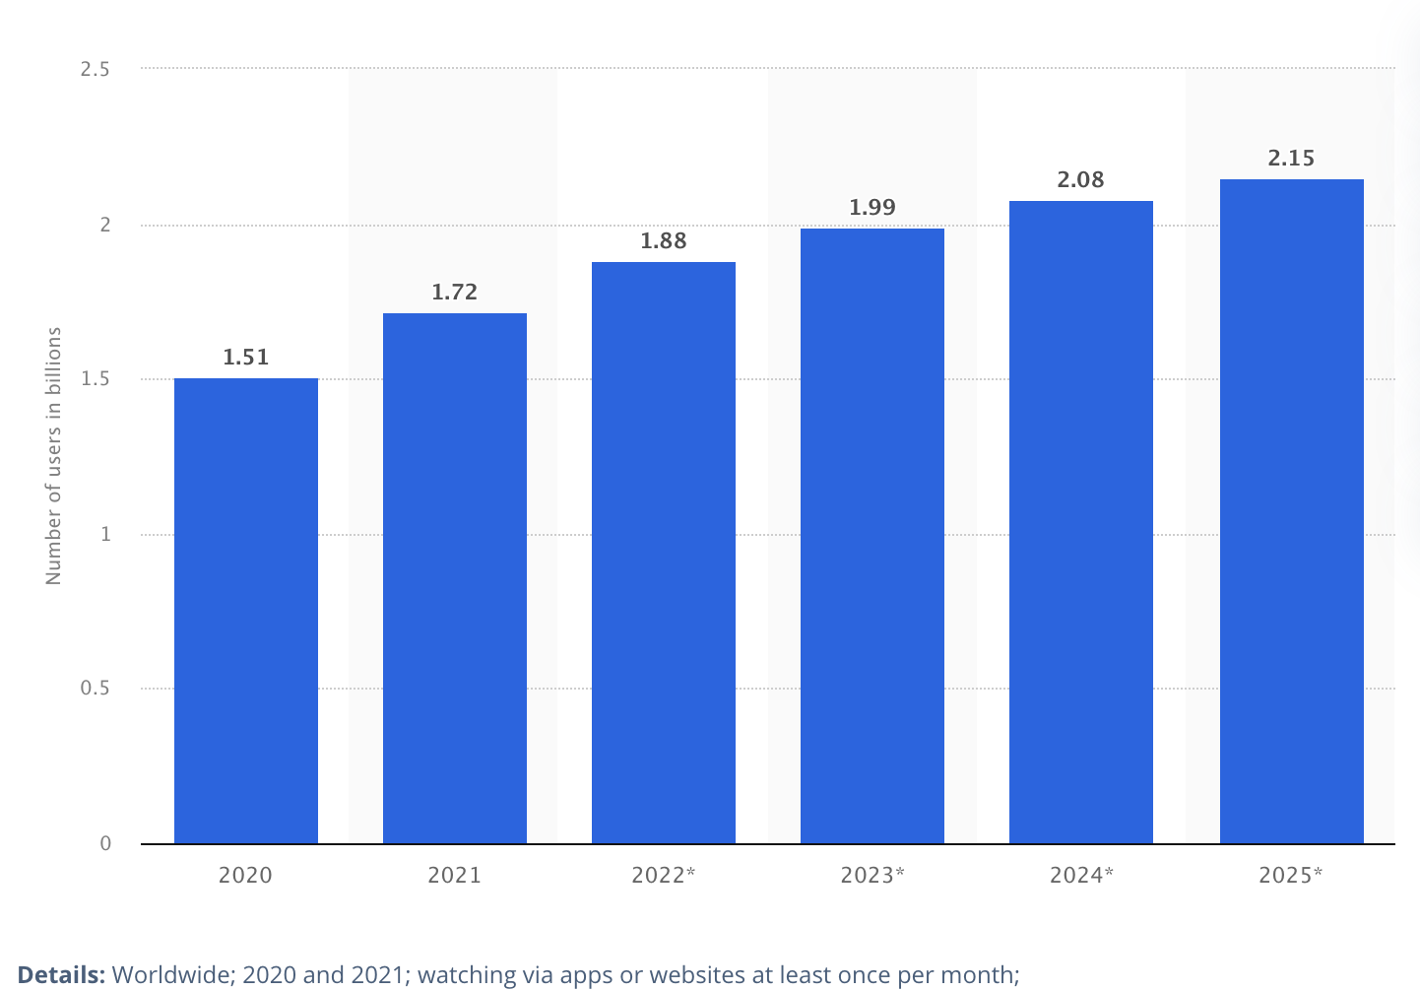
Background
Number of Global Users
2 billion users worldwide
https://www.statista.com/outlook/dmo/digital-media/video-on-demand/video-streaming-svod/worldwide
Notes:
According to Statista, the global user base for VSA applications has grown to 2 billion.

Slide 4

Background
LAN
WAN
(a) Traditional centralized cloud
(b) Geo-distributed edge platform
❌
✅
Notes:
Therefore, traditional centralized clouds (few sites connected by LAN) are struggling to provide a one-size-fits-all solution. As a result, more VSAs are being deployed in a decentralized manner on public edge platforms.

Slide 5
What’s Alibaba ENS?
More geo-distributed micro-datacenters
Built atop Alibaba CDN
Cooperative third-party IDCs and network operators
Contain 2800+ edge sites in global
Provide comprehensive services
FaaS, PaaS, IaaS, and heterogeneous computing (e.g., ARM SoC, FPGA)
100 million peak query per seconds (QPS)
Notes:
Our work is based on Alibaba ENS, one of the leading edge platform in China.
Specifically, it is built atop Alibaba CDN, it cooperate with third-party IDCs and network operators, and has more than two thousands and eight hundreds edge sites globally and nearly 800 edge sites in China.
It also provides comprehensive services:

Slide 6




The Older Story – QoS
QoS refers to the service quality of each component within end-to-end video delivery system.
Loss rate
Delay
End-users
ISP Gateway
Edge sites
Content origin sites
Fig 1. A example of end-to-end video delivery path.
Notes:
In both academic and industry, QoS optimization has been a widely researched topic for many years.
QoS refers to the service quality of each component within end-to-end video delivery system such as the loss rate and delay of various layers.
The following picture shows an example of end-to-end video delivery path. The end-users connect to the nearby edge sites through ISP gateway.
There are also some circumstances that the edge site within the ISP local zone, so the end-user directly connects to the edge sites without passing the ISP gateway.
If the edge sites don’t contain the required data, it will fetch from the content origin sites.

Slide 7
The Newer Story – QoE
ITU first defines QoE with Mean Opinion Score (MOS).
A subjective metric ranging from 1 to 5.
Subjective metrics are expensive/complicated to collect and are unreliable.
Similar to prior research, we primarily focus on objective QoE such as stall/rebuffer ratio and startup delay. ^{[1]}
[1] Xiaoqi Yin, Abhishek Jindal, Vyas Sekar, and Bruno Sinopoli. 2015. A control-theoretic approach for dynamic adaptive video streaming over HTTP. In Proceedings of the ACM SIGCOMM Conference. 325–338.
Notes:
In recent years, QoE has become the focus of people's attention.

Slide 8
How QoS and QoE matter?
Delivery Performance
Quality of Experience
Business Outcomes
impact
impact
💡For example, a 100ms decrease in page load time can lead to an 8% better conversion rate for retail sites (around 4 billion dollars) ^{[2]}.
[2] Deloitte Digital. 2020. Milliseconds make millions: A study on how improvements in mobile site speed positively affect a brand’s bottom line. https://bit.ly/3rpm8WP.
Notes:
Overall, the QoS has a direct impact on QoE, which finally influence the business outcomes such as the conversion rate and market share.

Slide 9
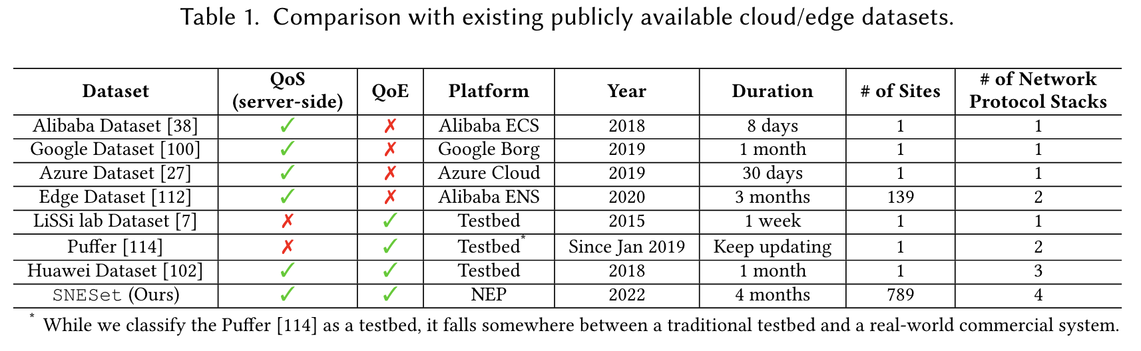
Limitations of Existing Datasets
(1) Comprehensive coverage
(2) Collected from large-scale
platform in the wild
Notes:
However, the existing open source datasets fall short in two aspects:
The first one is comprehensive coverage of both QoS and QoE metrics
The second one is collected from large-scale platform in the wild.
For example, the existing open-source datasets that contain QoE metrics are mainly collected from self-developed testbeds.

Slide 10
SNESet: The SOTA of QoS and QoE Datasets
💡 SNESet, an active measurement of 8 VSAs spanning four months in 2022, covering end-users from 798 edge sites, 30 cities, and 3 ISPs in China.
Notes:
So, to fill this gap, we have collected Sneset,

Slide 11
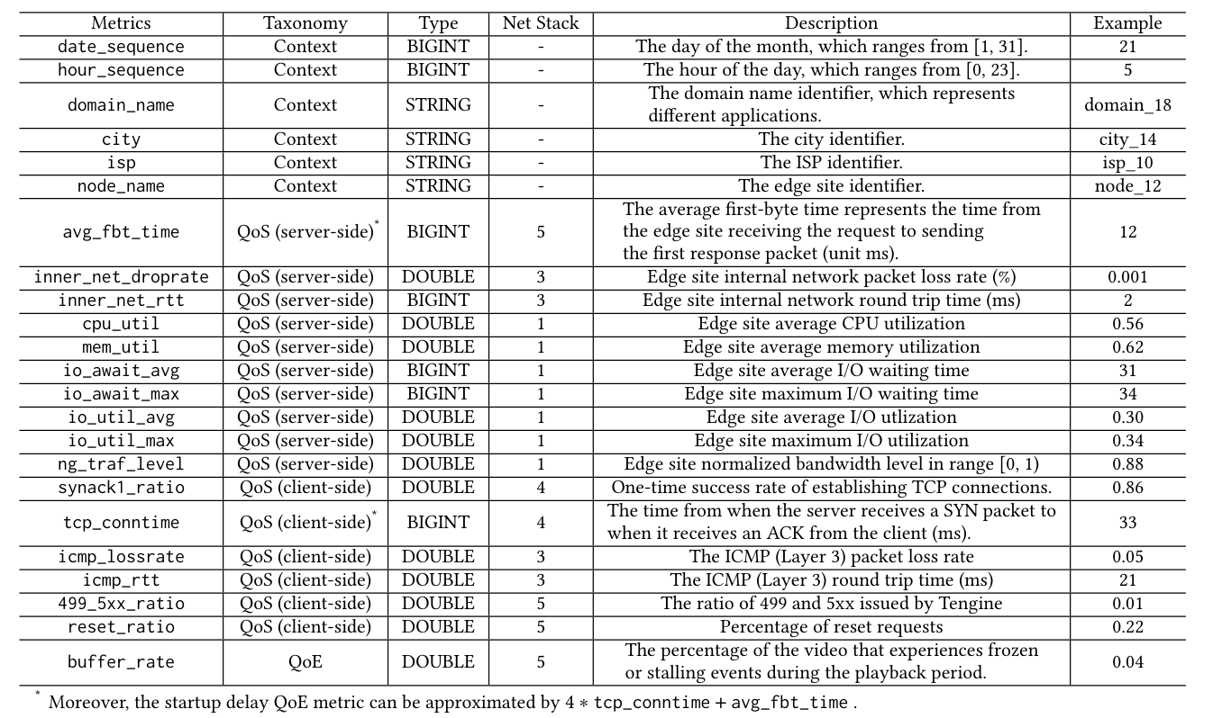
Comprehensive Coverage of SNESet
Context Info
6/23
Notes:
Specifically, Sneset has 6 context information metrics such as date, hour, city etc.

Slide 12
Comprehensive Coverage of SNESet
Link & Physical Layer
（Layer 1 & 2）
7/23
Notes:
Seven metrics of Link & Physical Layer such as the cpu, memory, and I/O utilization.

Slide 13
Comprehensive Coverage of SNESet
Network Layer
（Layer 3）
4/23
Notes:
Four metrics of network layer, such as the internal network loss rate and round trip time.

Slide 14
Comprehensive Coverage of SNESet
Transport Layer
（Layer 4）
2/23
Notes:
There are 2 metrics of Transports layer, which is the TCP one-time success rate and one round connection time.

Slide 15
Comprehensive Coverage of SNESet
Application Layer
（Layer 5）
5*/23
Notes:
For application layer, layer 5, we have 5 metrics.
Three of them are about the operating status of Tengine, while the other two are QoE metrics: stall ratio and startup delay.

Slide 16
Data Collection System
Notes:
In this picture, we introduce the overall architecture of our data collection system, which mainly consists of three components, located at end-user devices, edge sites, and the centralized cloud, respectively.

Slide 17
Data Collection System
Notes:
The Media Player on end-users’devices utilizes various protocols such as HTTPS/RTMP/WebRTC to download video chunks from the allocated edge sites. The Analytics Client collects various events and properties from the Media Player, transforms to the necessary metrics, and transfers to an analytics server in the same edge sites.
The analytics server aggregates these metrics from thousands of end-users at the same edge site within a coarser time granularity to produce the aggregated QoE metrics. Moreover, tsar is utilized to collect the QoS telemetry data.
The QoS and QoE data stored at each edge site are merged and transmitted to the central cloud through HTTPS, and then fed into typical message queues for further online and offline processing.

Slide 18
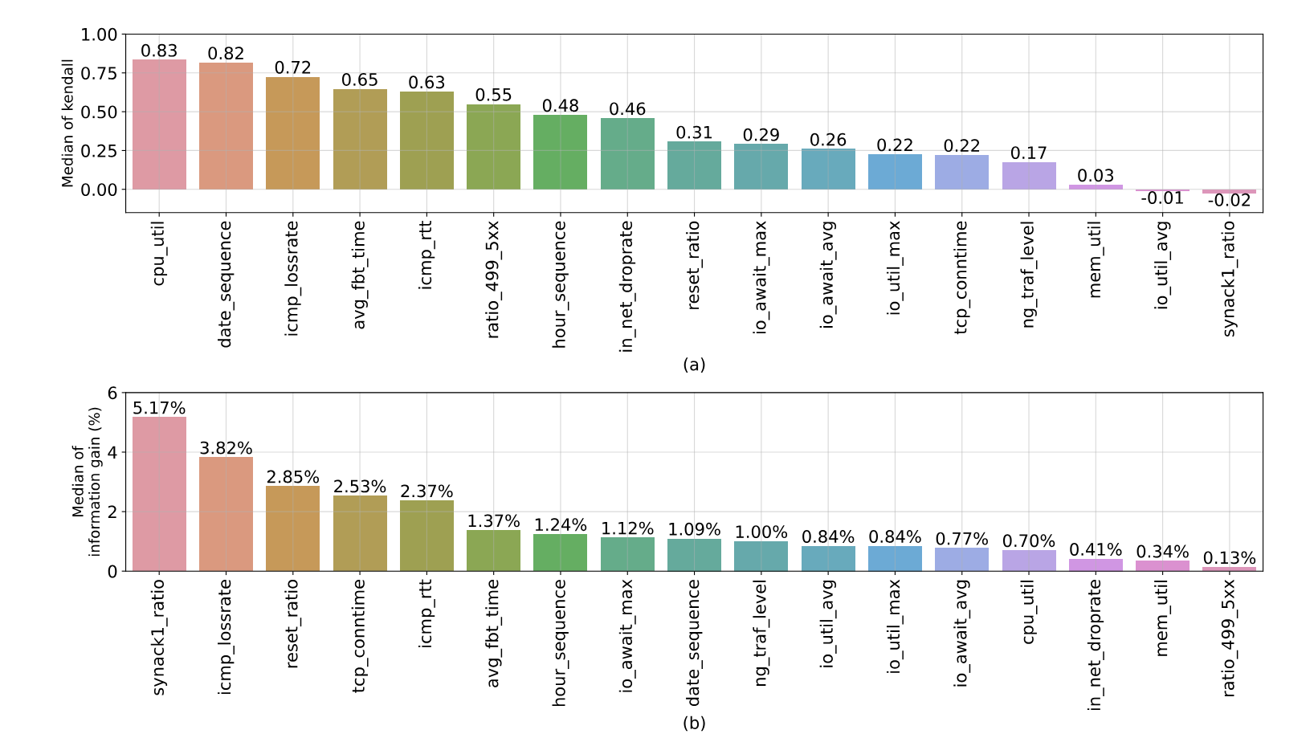
Qualitative Analytics
Kendall Correlation
Implications
End-to-end performance is critical.
Co-locate with memory or I/O-intensive services.
Complementary
Information Gain
Notes:
The next part of our paper involves both qualitative and quantitative analysis of how different QoS metrics influence QoE metrics.
For qualitative analytics, we mainly utilize the Kendall correlation and the Information Gain.
Kendall correlation provides a first order summary of monotone relationships between QoS metrics and the corresponding QoE metric. The information gain can corroborate or augment the correlation when the relationship is not monotone. Further, it provides a more in-depth understanding of the interaction among the QoS metrics by extending to the multivariate case.
Here the main implications are:
QoS metrics related to end-to-end performance are the most influential factors for QoE.
Since the value of memory utilization is close to zero, edge service providers may consider to co-locate the memory-intensive services with the VSAs.

Slide 19
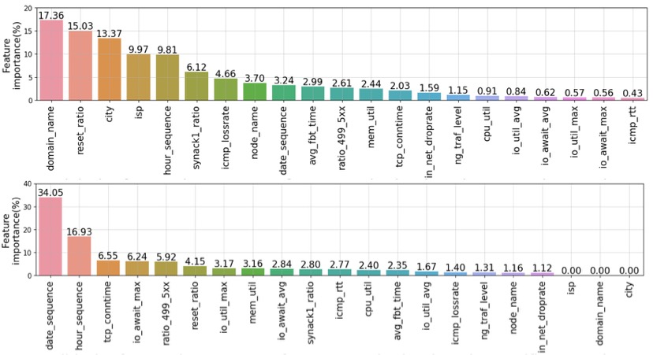
Quantitative Analytics
CatBoost feature importance score
Domain-
agnostic
Domain-
specific
Implications:
One-size-fits-all QoS-based QoE prediction model aren’t appliable.
Notes:
We utilize 6 regression models to quantitative analyses the QoS and QoE relationship.
In this picture, we present the feature importance of Catboost in both domain-.
The main implication are: One-size-fits-all QoS-based QoE prediction model aren’t appliable, which need specific design for each domain or edge sites.
Please refer to our paper for more results and analysis.

Slide 20
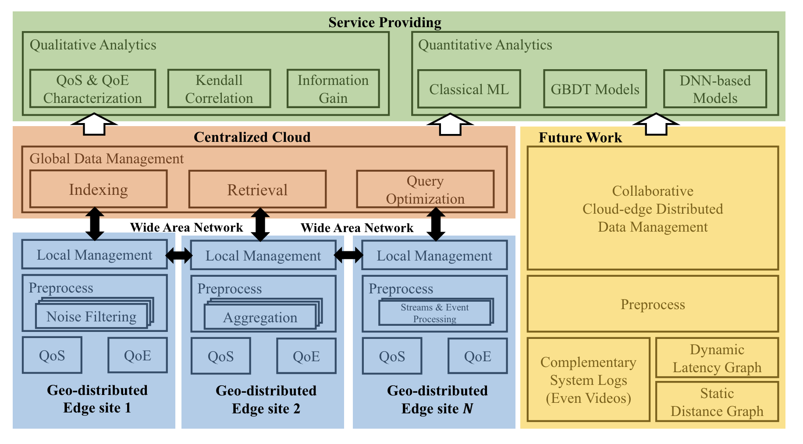
Potential Data-centric Problems
Data management
Data preparation
Data collection
Notes:
Finally, we also discuss some potential data-centric problems that need further efforts to overcame.
Data collection requires both lightweight implementations and low runtime costs. The former entails collecting data in a non-intrusive manner to minimize modifications to the existing codebase. The latter requires minimizing the impact of data collection on application performance, such as delay and throughput, during runtime.
data processing, which generally includes the cleaning, transforming, and augmenting raw data for downstream tasks. Each edge site generates massive daily data volumes, contributing to the overall data scale of NEP reaching petabytes. Filtering redundant information and reducing complexity (feature size or sample size) are crucial for resource-constrained edge sites. In contrast, data augmentation enhances diversity and addresses class imbalance issues.
Currently, each edge site transmits all QoS and QoE to the centralized cloud for management via HTTPS. However, the centralized data management exist the limitations of significant network bandwidth overhead and transmission time consumption. To address these challenges, there is an urgent need for a cloud-edge collaborative distributed data management system.

Slide 21
Data Collection Challenges
Future Work
Objectives: Accurately reflects end users’ QoE while minimizing the costs.
Lightweight implementations;
Low runtime costs;
Efficient integration with both the internal and external datasets.
Collaborative
Cloud-edge Distributed
Data Management
Preprocess
Complementary
System Logs
(Even Videos)
Dynamic
Latency Graph
Static
Distance Graph
Notes:
Data collection involves gathering and acquiring data, which fundamentally determines its quality and quantity.
The challenge is to accurately reflect end users’ QoE while minimizing costs.
This may include efforts towards lightweight implementations, low runtime costs, and efficient integration with both internal and external datasets.

Slide 22
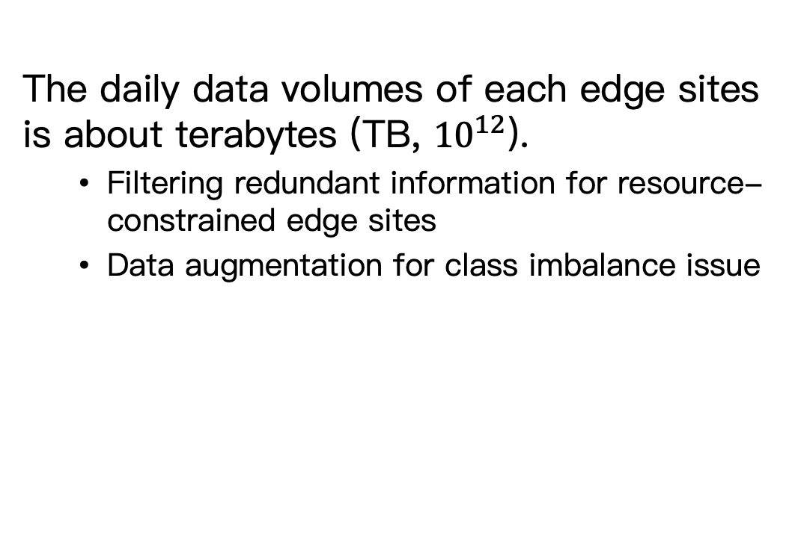
Data Preparation Challenges
Future Work
The daily data volumes of each edge sites is about terabytes (TB, ${10}^{12}$).
Filtering redundant information for resource-constrained edge sites
Data augmentation for class imbalance issue
Collaborative
Cloud-edge Distributed
Data Management
Preprocess
Complementary
System Logs
(Even Videos)
Dynamic
Latency Graph
Static
Distance Graph
Notes:
Data preparation involves pre-processing raw data for upper-layer management and analytics.
Currently, the daily data volumes of each edge site is approximately terabytes.
Thus, filtering redundant information is crucial for resource-constrained edge sites.
Additionally, data augmentation is necessary to address imbalanced classes.

Slide 23
Data Management Challenges
Future Work
Limitations of the existing centralized data management:
Network bandwidth overhead
Transmission time consumption.
Key considerations:
Diverse data type: structured QoS, semi-structured QoE/system logs, graph data, and even videos.
Large-scale geo-distributed sites connected through WAN.
Automated materialized views
Collaborative
Cloud-edge Distributed
Data Management
Preprocess
Complementary
System Logs
(Even Videos)
Dynamic
Latency Graph
Static
Distance Graph
Notes:
Existing centralized data management systems suffer from significant network overhead and long transmission times.
To overcome these challenges, a cloud-edge collaborative data management approach is urgently needed.
This approach faces three unique challenges:
Handling diverse underlying data types.
Managing large-scale, geo-distributed sites connected through WAN.
Implementing automated materialized views to ensure low latency and high throughput for concurrent query requests.

Slide 24

Conclusions
Research Track
Data-intensive Applications (DIA) Special Track
We have collected SNESet, which contains both QoS and QoE metrics for eight VSAs on a large-scale edge platform using active measurements.
Qualitatively and quantitatively analyze the impact of different QoS metrics on QoE in both domain-agnostic and domain-specific scenarios.
Potential data-centric problems.
Thanks for listening!
Paper: Demystifying the QoS and QoE of Edge-hosted
Video Streaming Applications in the Wild with SNESet
Dataset & Code: https://github.com/YananLi18/SNESet
Acknowledgments:
Special thanks to Alibaba Group
Mail to: YaNanLi@bupt.edu.cn

